Slide 1
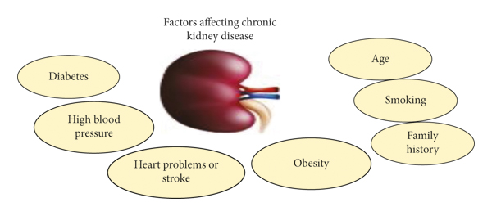
AN EFFECTIVE KIDNEY DISEASE DETECTION AND SEVERITY LEVEL CLASSIFICATION MODEL USING MACHINE LEARNING
Name : SIVA KEERTHANA V
Reg. No : C21PG124CSC033
Course : II – M.Sc.Cs
Guide By : Dr. S.Gomathi

Slide 2
CONTENT
ABSTRACT
MODULES
EXISTING SYSTEM
PROPOSED SYSTEM
SYSTEM ARCHITECTURE
SAMPLE INPUT
SAMPLE OUTPUT
CONCLUSION

Slide 3
ABSTRACT
Chronic kidney disease (CKD) is one of the most critical health problems due to its increasing prevalence. But CKD is a disease which doesn't shows symptoms at all .
But machine learning can be hope in this problem it is best in prediction and analysis. Chronic Kidney Disease dataset has been taken from the UCI repository.
By using Logistic Regression algorithm to predict an accurate result of a person affected the level of the kidney disease.
MAJOR SYMPTOMS:
Weight loss and poor appetite.
Shortness of breath.
Tiredness.
Blood in your pee (urine)

Slide 4
MODULES
PANDAS - Pandas is a Python library used for working with data sets. It has functions for analyzing, cleaning, exploring, and manipulating data.
NUMPY - NumPy can be used to perform a wide variety of mathematical operations on arrays.
SCIKIT LEARN - Scikit-learn (Sklearn) is the most useful and robust library for machine learning in Python. It provides a selection of efficient tools for machine learning and statistical modeling including classification, regression, clustering and dimensionality reduction via a consistence interface in Python.
SEABORN - Seaborn is a library for making statistical graphics in Python. It builds on top of matplotlib and integrates closely with pandas data structures. Seaborn helps us explore and understand our data.
MATPLOTLIB - Matplotlib is a comprehensive library for creating static, animated, and interactive visualizations in Python. Matplotlib makes easy things easy and hard things possible. Create publication quality plots.

Slide 5
EXISTING SYSTEM
DESCRIPTION
Many researches are implementing different machine learning algorithms to identify accuracy level of prediction.
In existing system also the prediction of particular patient as normal or abnormal is predicted with different accuracy rate.
DRAWBACKS
Accuracy level of prediction increases and need to improve.
No intimation or alert message is notified.
Minimum number of dataset is used for processing should be improved to increase accuracy of prediction.

Slide 6
PROPOSED SYSTEM
DESCRIPTION
The patient is affected by CKD or not two parameters such as Sugar level and blood pressure is considered and verified with normal value of a human being if particular value is normal it will be intimated as normal or it is nearer to limit value then it will be notified to particular person as a alert message.
Hence it create an alert to take precaution steps to have a healthy life.
ADVANTAGES
Accuracy of prediction is increased.
Notification of patient level is intimated based on 2 parameters.
More number of dataset is included in processing increases accuracy level in prediction.

Slide 7
SYSTEM ARCHITECTURE
USER INPUT
CKDPS DIAGNOSIS USER INPUT TO PREDICT CKD
DIAGNOSIS RESULT
CKDPS DISPLAYS DIAGNOSIS RESULT TO THE USER

Slide 8
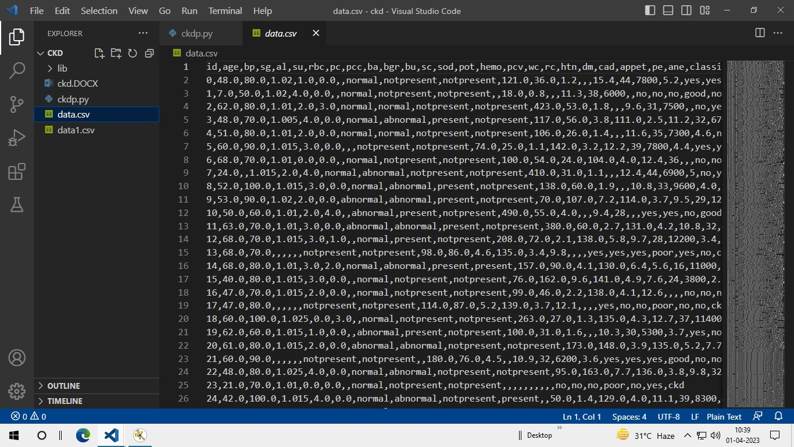
DATASET

Slide 9
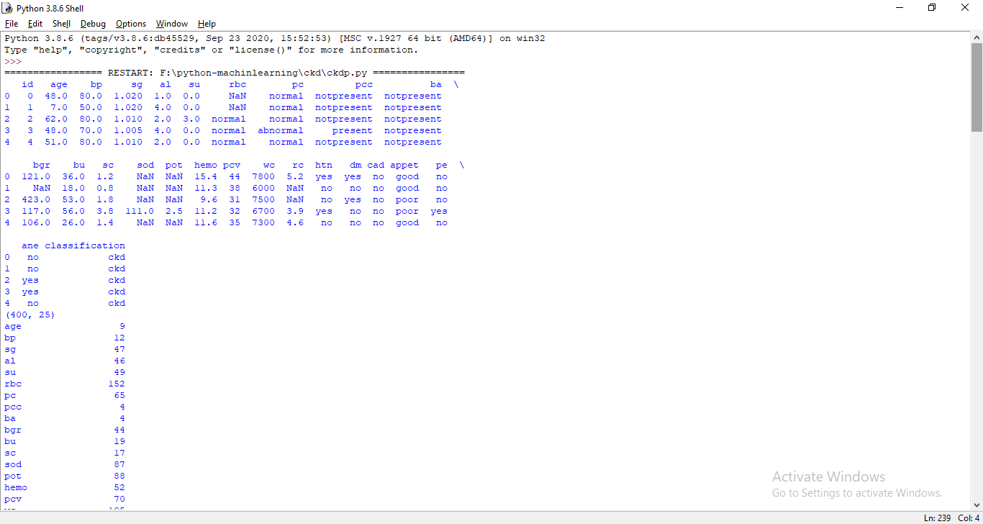
SAMPLE INPUT

Slide 10
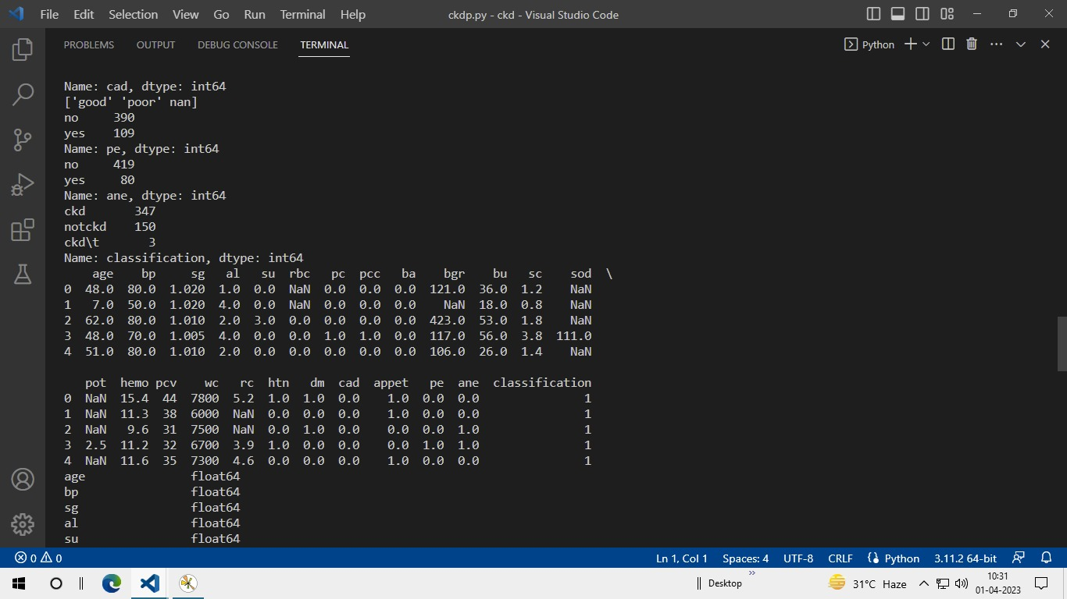
SAMPLE OUTPUT

Slide 11
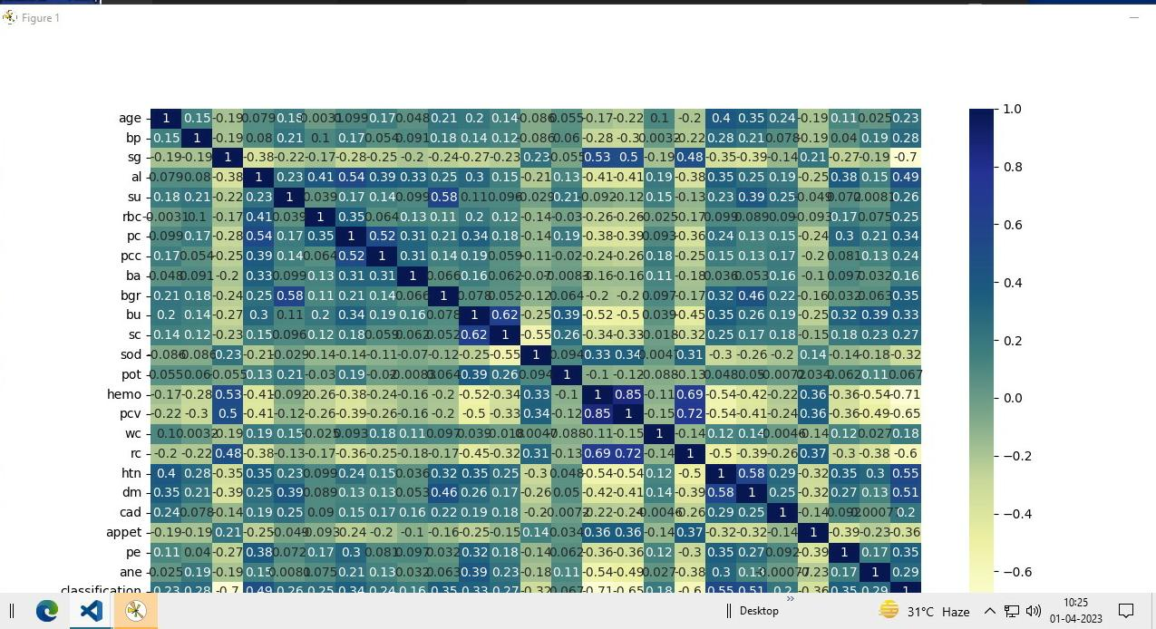

Slide 12
CONCLUSION
The machine learning techniques present different levels of accuracy for the CKD diagnosis depending on the number of attributes considered during the classification.
In this study, the gradient boosting exhibited the best performance using the CKD dataset, comprising of hypertension, DM, creatinine, urea, albuminuria, age, gender, and GFR attributes.
These attributes are commonly used by nephrologists to diagnose CKD in developing countries

Slide 13
THANK YOU

